Slide 1

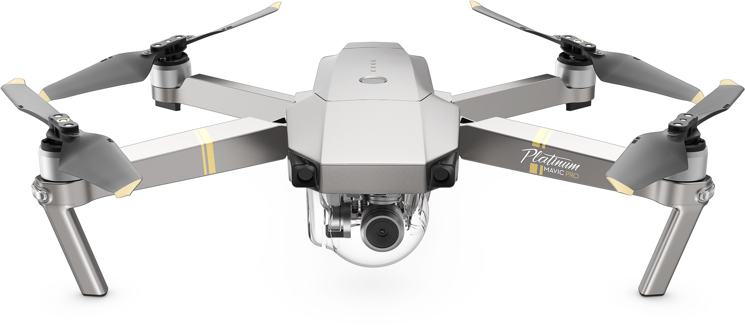
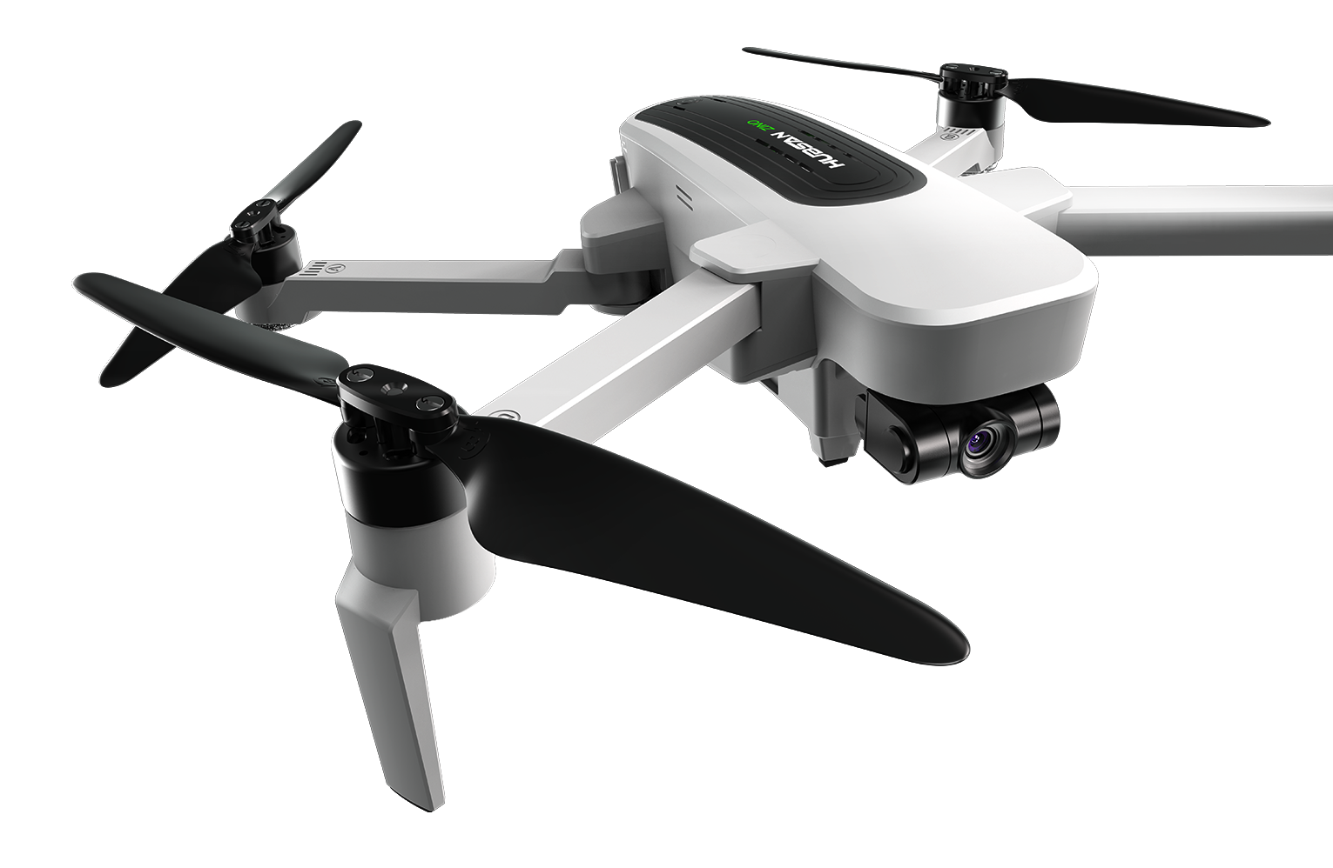
AEROMODELLING CLUB
DRONE BOOTCAMP
This Photo by Unknown Author is licensed under CC BY-NC
This Photo by Unknown Author is licensed under CC BY-NC

Slide 2

Project Mentors
Pranshu Singhal
Mohit Anand
Moin Ahmed
Raj Agarwal

Slide 3

AIM :
This project aims at providing us an insight into the following engineering fields:
1. Exploring theoretical concepts like kinematics, dynamics and PID control of drones.
2. Working on simulation software like mission planner .
3. Introduction with robot operating system.
Mentees will be able to fabricate their own drone and start controlling it with a deep sense of physics behind it.

Slide 4
Basics of Aeromodelling
We started off our project by learning about all the basic terminologies of aeromodelling like Pitch, Yaw, Roll, Control surfaces, Propellors, Airfoils and also about the different kinds of Airplanes and Drones.
Pitch-Rotation of an aircraft or drone about left-right axis.
Roll-Rotation of an aircraft or drone about front- back axis.
Yaw-Rotation of an aircraft or drone about the vertical axis through its body.

Slide 5
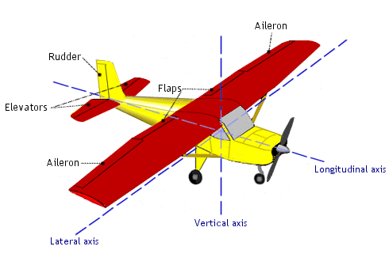
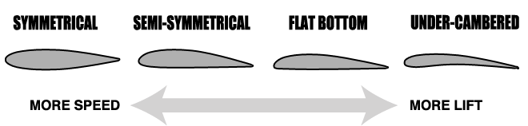
Control Surfaces:-
Elevators : They help in pitching motion of the aircraft.
Ailerons : They help in rolling motion of the plane.
Rudder : They help in yaw motion of a plane.
Airfoil : These are curved surfaces designed to give the most favourable ratio of lift to drag during a flight.
Symmetrical
Flat bottom
Under camber

Slide 6
Avionics
Brushless DC Motor: These are used to provide power to the propellors of a drone so they can rotate.
ESC(Electronic speed controller): Used to control RPM of BLDC motors.
Servo Motor: It acts as an actuator to control position, velocity and acceleration.
Receiver: It receives signal from transmitter and gives the output as PWM values.
Transmitter: It transmits the signal received by receiver.
Battery: It gives power to the motors to fly the drone.
IMU: It consists of an accelerometer, a gyroscope and a magnetometer.
Flight Controller : It is known as the brain of aircraft. It consists of sensors which helps to detect the movement of drone in flight and also gives commands.
Radio Telemetry: It is used to collect real time data of flight parameters during motion.
GPS: Used to locate and navigate the drone during its motion.
BMP Sensor: Measures pressure and temperature and also used as altimeter.

Slide 7
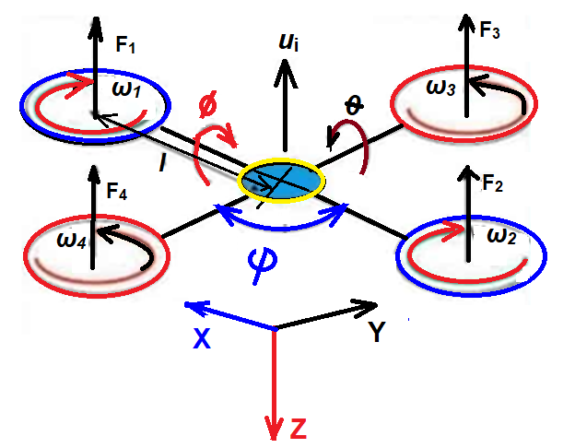
What is a Quadcopter ?
A quadcopter or quadrotor is a simple flying mechanical vehicle that has four arms, and in each arm, there is a motor attached to a propeller.
Two of the rotors turn clockwise, while the other two turn counter-clockwise.
It comes with a 4-channel flight controller which helps in controlling its pitch, roll, yaw and throttle. It can connect to several other devices and sensors. The primary device that it connects to is the remote-control receiver, which is linked to the remote transmitter.
Flight controllers basically change the speed of motors and bring the movement of the drone.
Quadcopters are an economical way to introduce yourself to the world of remote-control aerial vehicles.

Slide 8
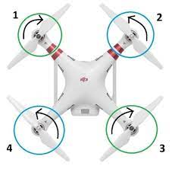
Respective Movements
1. PITCH
2. ROLL
3. YAW
We can rotate the body about the pitch by increasing or decreasing the rotating speed of propellers combination of (1and 2) and (3 and 4) according to the respective movements.
We can roll the body to the right or left by increasing, decreasing the combination of (1 and 3 ) and (2 and 4).
Make 1 and 3 slow and 2 and 4 fast to roll it in the left.
Similarly,1 and 3 fast and 2 and 4 slow to roll in the right.
In this we keep the diagonally opposites propellers in the same speed and another opposite pair in the same to give the body a torque and rotate it about the perpendicular axis.

Slide 9
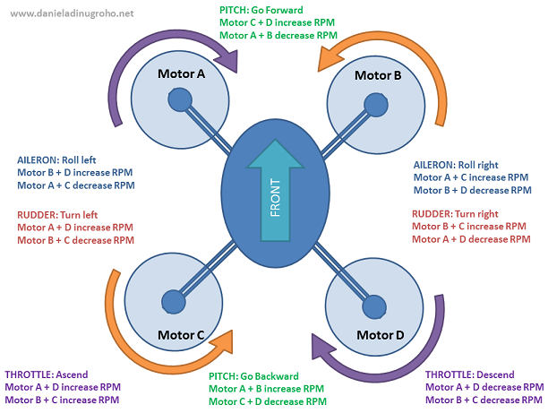
CONTROLLING OF A DRONE

Slide 10
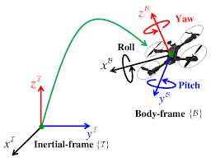
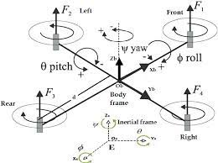
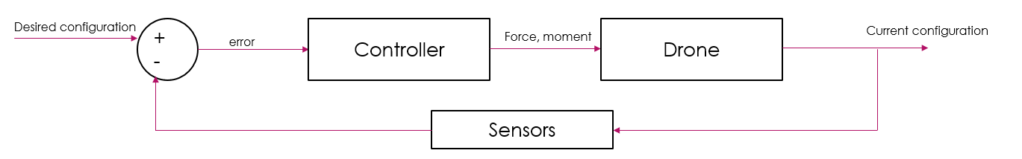
DRONE KINEMATICS

Slide 11
Control Theory
Most of the control theory itself Focuses on modeling physical systems as linear in time invariant
Key properties of LTI systems:
1. Obey principle of superposition
2. Homogeneity
3. Time invariance
Although no system is perfectly linear, but they behave linearly under some conditions and linear systems are much easier to solve.
Components to PID control:
1. Proportional
2. Integral
3. Differential

Slide 12
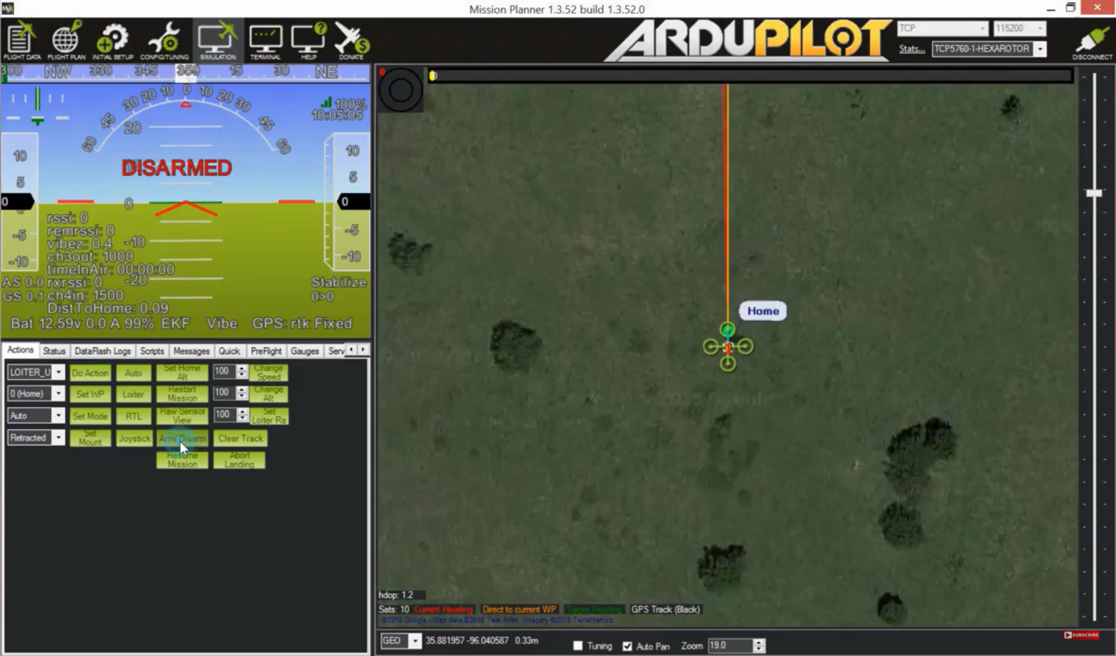
Mission Planner
It used for dynamically controlling and receiving real time information about your aerial vehicle.
Using Software-in-the-loop feature allows us to virtually fly aerial vehicles without any hardware. It works on autopilot principle, and we can plan and execute missions using it.

Slide 13
PROGRESS AND TIMELINE
TOPIC | TIME
INTRODUCTION, TYPES AND TERMINOLOGIES OF AIRCRAFT. | 5 DAYS
1ST DISCUSSION SESSION – MISSION PLANNER AND INTRO. | 24TH MAY 2021 – 1 DAY
EVALUATION TEST | 30TH MAY 2021 – 1 DAY
2nd DISCUSSION SESSION – DRONE AVIONICS | 30TH MAY 2021 – 1 DAY
3RD DISCUSSION SESSION – DRONE KINEMATICS | 2nd JUNE 2021 – 1 DAY
LEARNING DRONE AVIONICS AND KINEMATICS | 6 DAYS
ASSIGNMENT 1 | 5TH JUNE TO 10TH JUNE 2021 - 6 DAYS
4TH DISCUSSION SESSION – BASICS OF MISSION PLANNER | 5TH JUNE 2021 – 1 DAY
LEARNING PID CONTROL | 4 DAYS
5th DISCUSSION SESSION – DRONE DYNAMICS | 9TH JUNE 2021 – 1 DAY
6TH DISCUSSION SESSION – DRONE DYNAMICS CONTD. | 12TH JUNE 2021 – 1 DAY
INSTALLING SOFTWARES LIKE UBUNTU, MATLAB, ETC. | 12TH JUNE 2021 – 1 DAY
MID-TERM EVALUATIONS | 13TH JUNE 2021 – CURRENTLY RUNNING

Slide 14

TEAM MEMBERS
Akanksha
Ayush
Nitin
Pranshu
Saurabh
Sheeshram
Utkarsh

